Slide 1

Computer Graphics

Slide 2
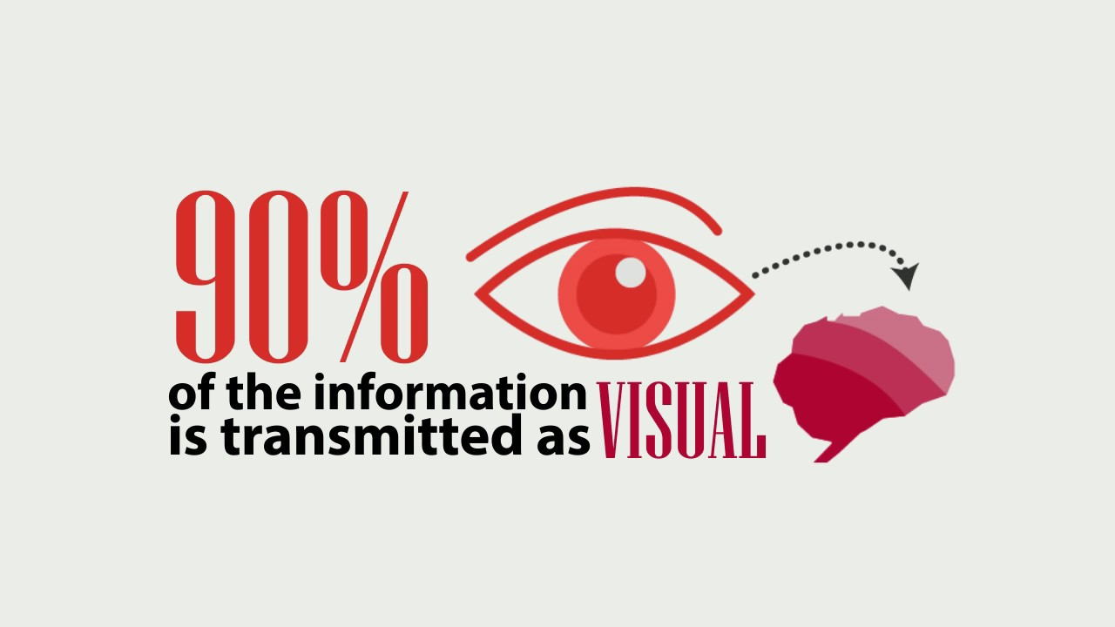

Slide 3
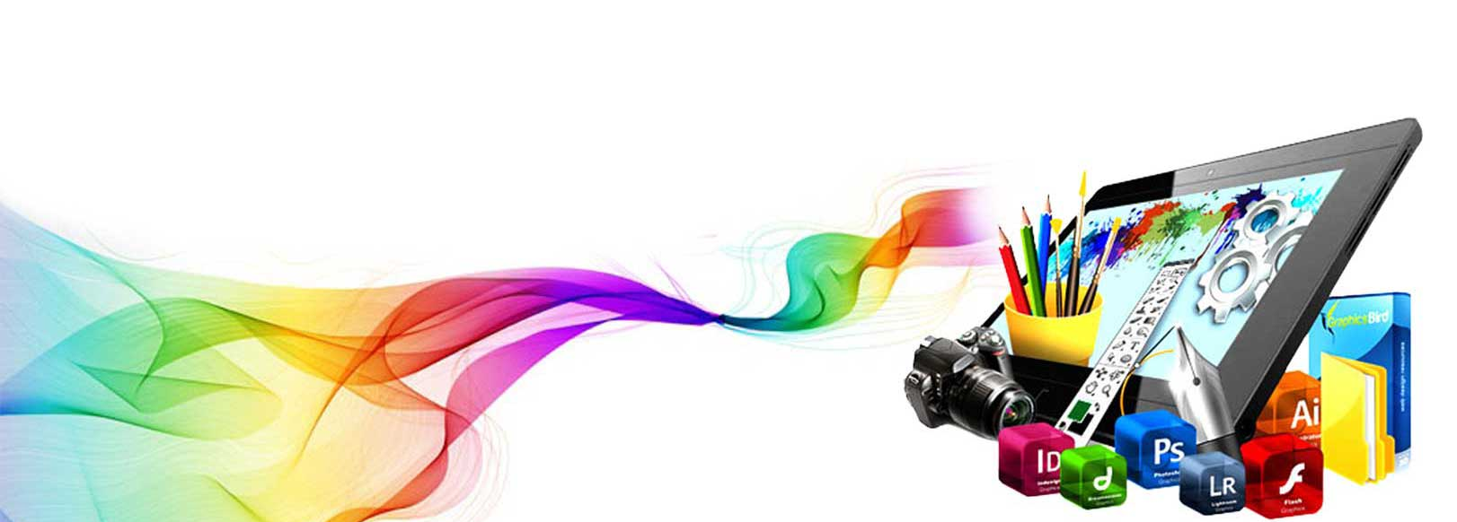
What is Computer Graphics?
Computer graphics is the display, storage & manipulation of images and data for the visual representation of a system
Computer graphics is an art of drawing pictures, lines, charts, etc. using computers with the help of programming.

Slide 4
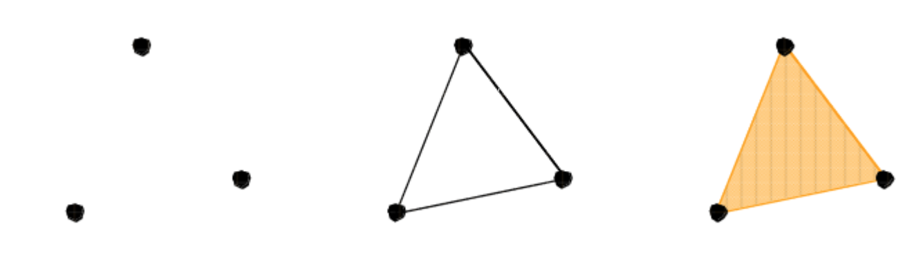
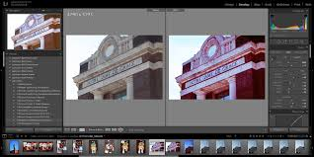
Digital Image Vs. Graphics
CG (Computer Graphics ) refers to processing of creating a new image from Geometry , Lighting parameters , Materials and Textures .Using a Computer or any other digital media.
While DIP(Digital Image Processing) is the process of manipulating an image acquired through some device . The image too often will be acquired from photographs, scanners , medical equipment.

Slide 5
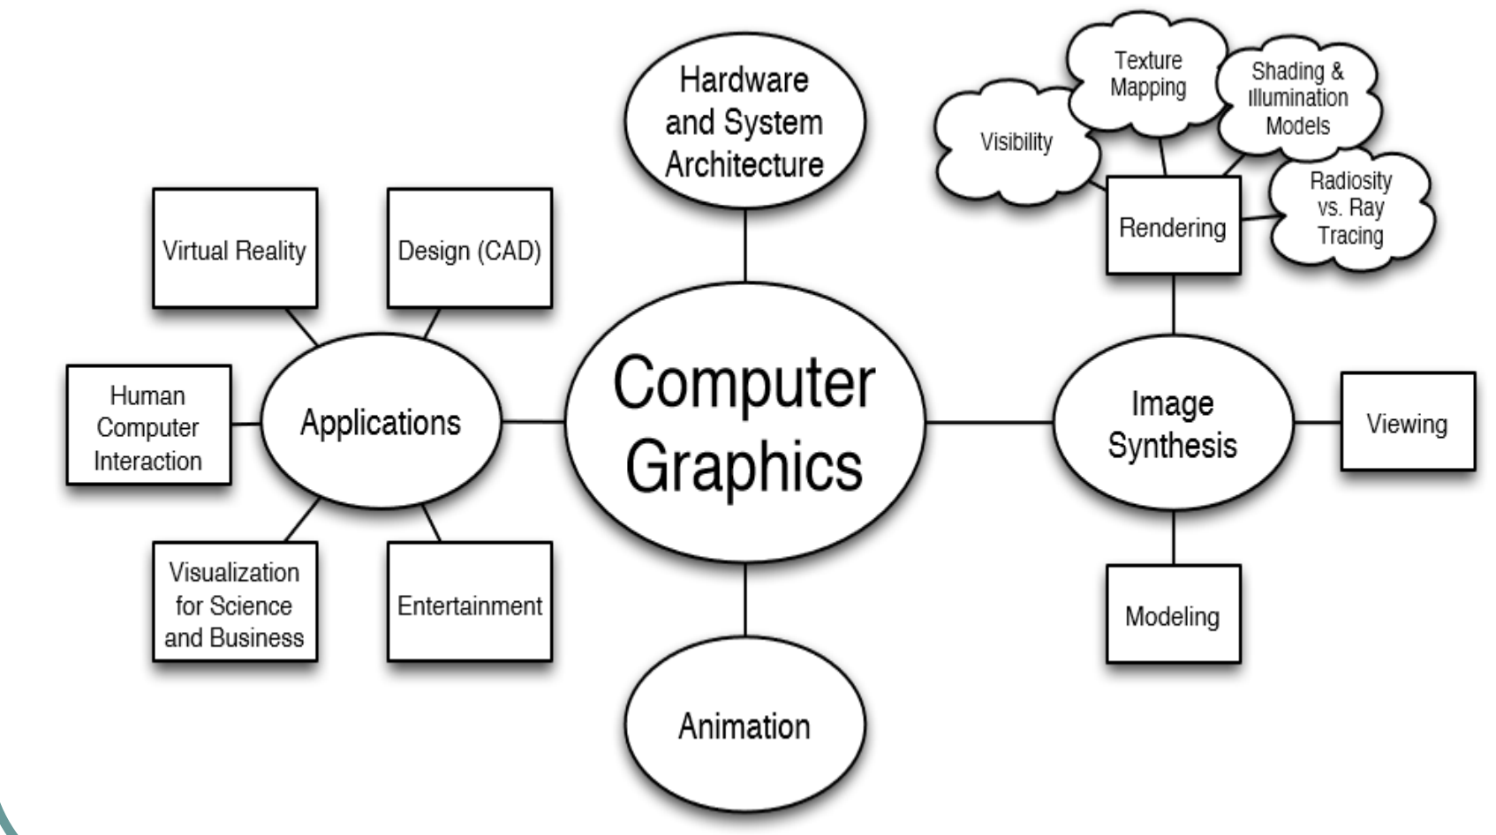
CG in a Nutshell

Slide 6

Applications of CG
Computer Aided Design (CAD)
Presentation Graphics
Entertainment (animation, games)
Education & Training
Computer Art
Scientific Visualization
Image Processing
Graphical User Interfaces

Slide 7
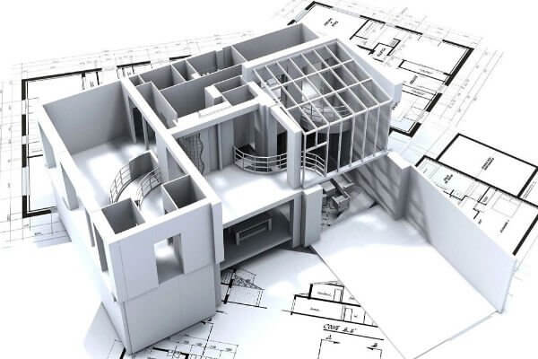
Computer Aided Design (CAD)
Used in design of buildings, automobiles, aircraft, watercraft, spacecraft, computers, textiles & many other products
CAD package provides standard shapes
Animations are also used in CAD applications
AutoCAD
Google Sketch up

Slide 8
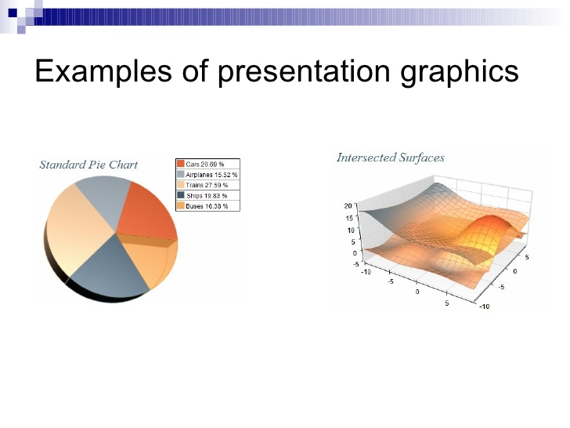
Presentation Graphics
Summarize financial, statistical, mathematical, scientific, economic data for research reports, managerial reports
Presentation Slides - Bar charts, Line graphs, Pie charts etc.

Slide 9
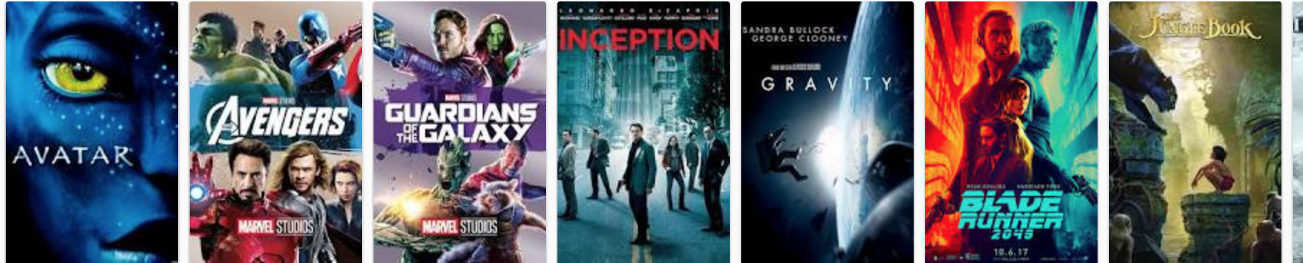
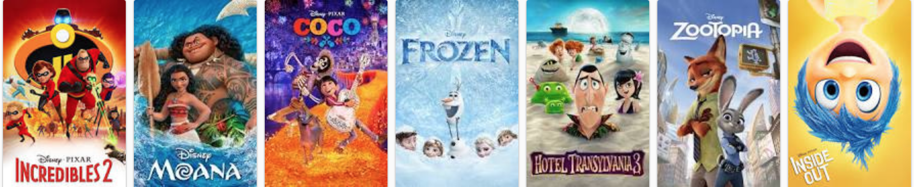
Entertainment
Movie Industry
Used in motion pictures, music, videos, and
television shows.
Used in making of cartoon animation films

Slide 10
Movie

Slide 11
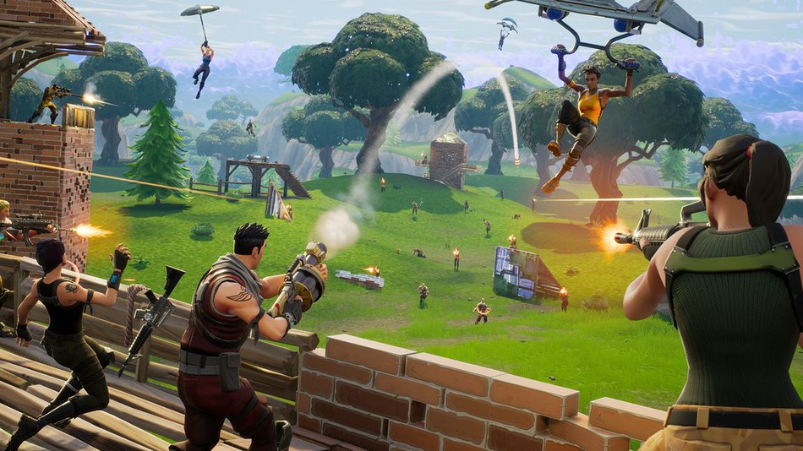
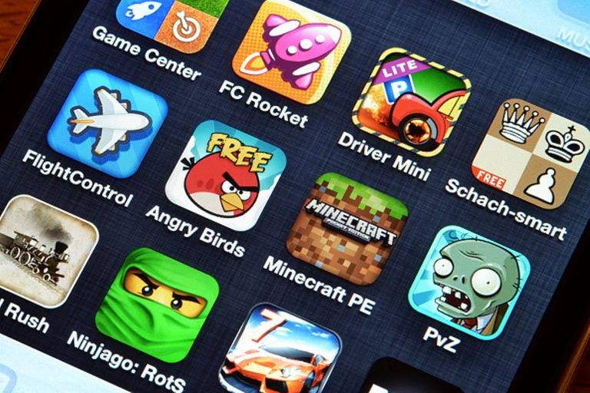
Entertainment
Games
Interactivity
Realistic vs Fictional Graphics
Huge revenue industry

Slide 12
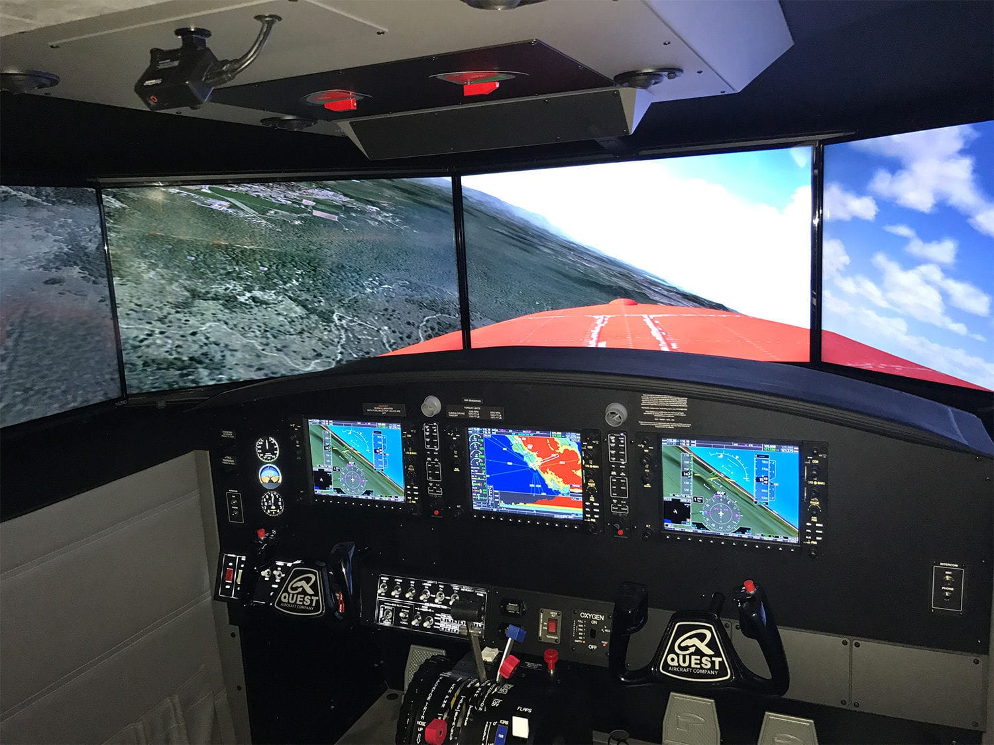
Education and Training
Computer generated models of physical, financial and economic systems are used as educational aids.
Models of physical systems, physiological systems, population trends, or equipment such as color-coded diagram help trainees understand the operation of the system
Specialized systems used for training applications
Simulators for practice sessions or training of ship captains
Aircraft pilots
Heavy equipment operators
Air traffic-control personnel

Slide 13
Computer Art
Computer art typically refers to any form of graphic art or digital imagery which is produced with the aid of a computer
Used in Fine Art & Commercial Art
Includes artist’s paintbrush programs, paint packages, CAD packages and animation packages
These packages provides facilities for designing object shapes & specifying object motions.
Cartoon drawing, paintings, product advertisements, logo design and branding

Slide 14
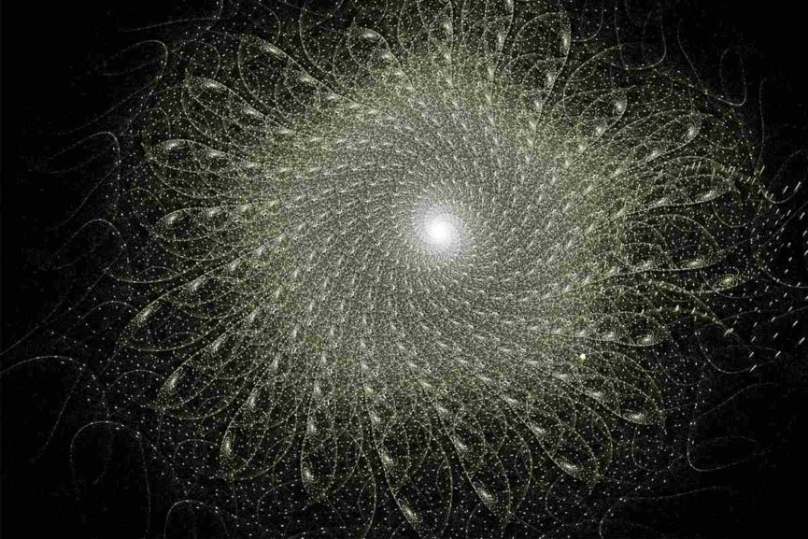
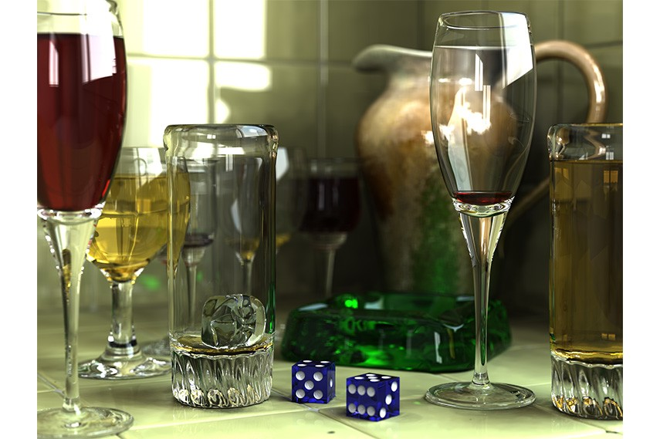
Computer Art

Slide 15
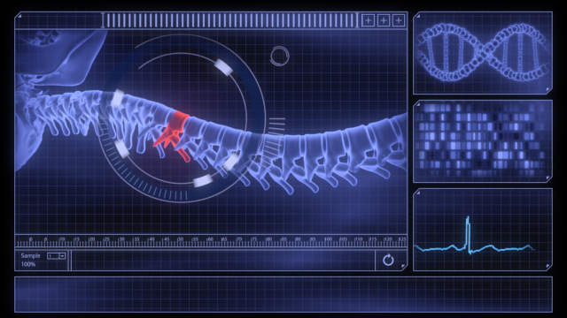
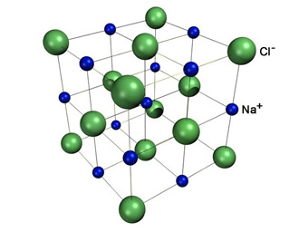
Visualization
Visualization is the process of representing data graphically and interacting with these representations in order to gain insight into the data.
Scientific Visualization
Producing graphical representations for scientific, engineering, and medical data sets
Scientists, engineers, medical personnel, business analysis, and others often need to analyse large amounts of information or to study the behaviour of certain processes.

Slide 16
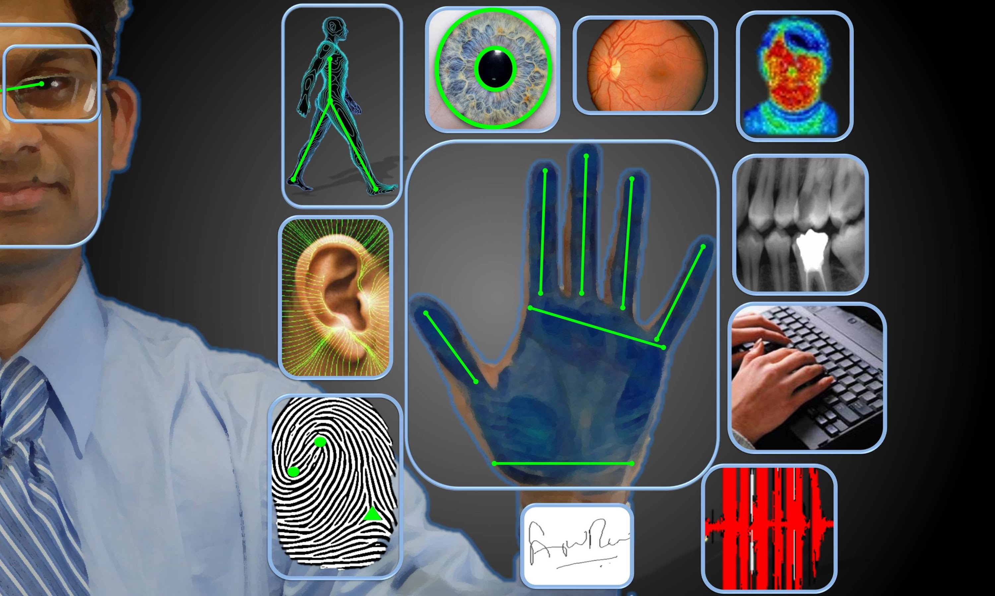
Image Processing
Image Processing applies techniques to modify or interpret existing pictures.
There are different examples of image processing in our daily life. It is used in
Image enhancement.
Law Enforcement
Medical
Moving object tracking...etc.

Slide 17
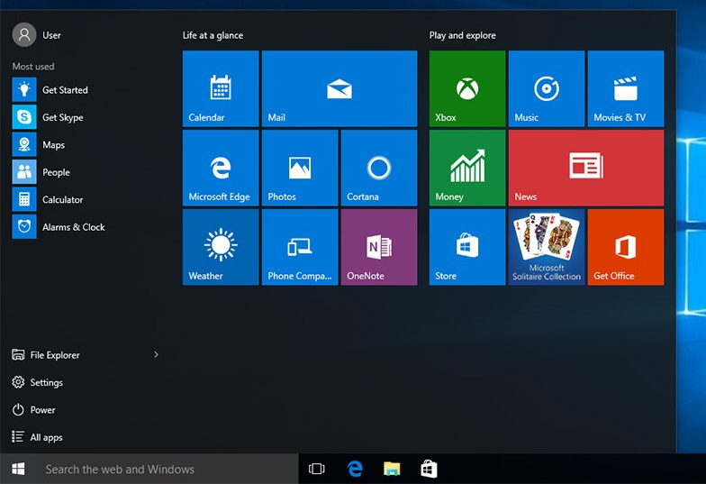
Graphical User Interface
Computer graphics is used to design: Menus, icons, cursors, dialog boxes, scrollbars, valuators, grids, 3d interface.
Lay user can easily use the computer with the help of GUI.
User don’t have to remember commands.
More interactive interface.

Slide 18
Components of CG
Modeling: Defining objects in terms of primitives, coordinates and characteristics.
Storing: storing scenes and images in memory and on disk.
Manipulating: changing the shape, position and characteristics of objects.
Rendering: applying physically based procedures to generate (photorealistic) images from scenes (using lighting and shading).
Viewing: displaying images from various viewpoints on various device.

Slide 19
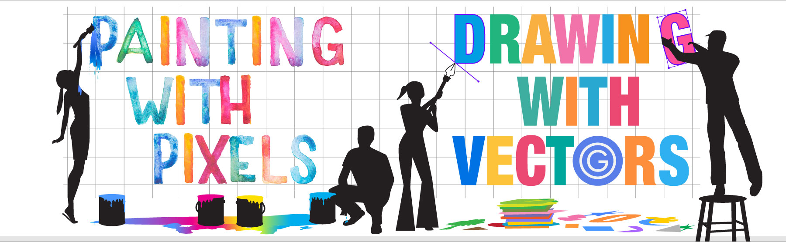

Slide 20
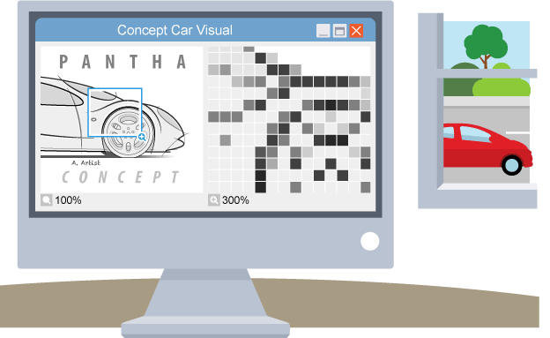
Bitmap vs Vector Graphics
Bitmap :
Often they are called raster graphics
When you create a bitmapped graphic you are basically creating a bunch of colored dots Pixels
Each pixel gets assigned a specific color
The more pixels you have, the more detailed the image can be

Slide 21
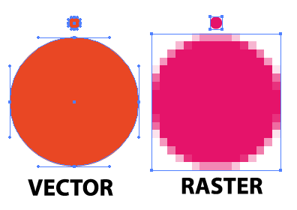
Bitmap vs Vector Graphics
Vector Graphics : Vector graphics are created and manipulated using drawing programs (as opposed to paint programs for bitmapped graphics)
Instead of using pixels to describe the image, it describes the image using shapes
Circles
Lines
Curves
Also has to store the color of these shapes

Slide 22
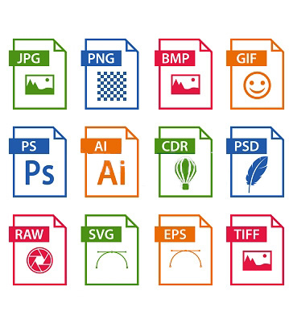
File Formats
Once we’ve chosen which graphics format we’re going to use now we have to select which file format
Each way of storing an image is called a file format
Each file format converts the image to a corresponding string of bits differently in order to store them on disk or transmit them over the Internet

Slide 23
Common File Formats
Bitmap Formats
GIF: graphics interchange format
JPEG: joint photographic experts group
PNG: portable network graphic
BMP: Windows bitmap
TIFF: tagged image file format
Vector Formats
SVG : scalable vector graphics
EPS: encapsulated postscript
CMX: Corel meta exchange
PICT: Macintosh Picture
WMF: Windows metafile

Slide 24
How to Pick a File Format?
Type: does the file format store the type of image you want to use (bitmap or vector)?
Portability: can other people use images in this format?
Color Depth: does the format support the number of colors you need?
Compression: can make the file smaller, but it takes time to compress and decompress a file
Transparency: do parts of your image need to be transparent?

Slide 25
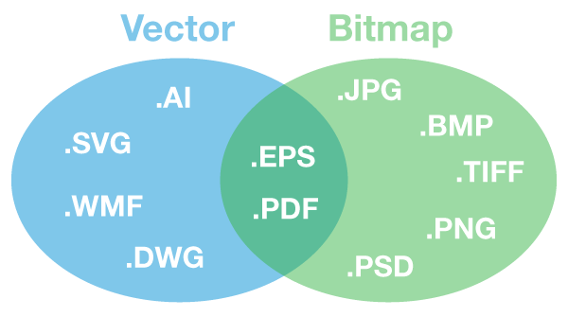
How to Pick a File Format?

Slide 26

Thank you
Notes:
https://www.youtube.com/watch?v=cNN_tTXABUA

